Slide 1



AI-POWERED DROWSINESS DETECTION SYSTEM USING DEEP LEARNING
Presented By,
Snajay J (811722104129)
Sanjay N (811722104130)
Santhosh J (811722104133)
SundarPrasath J (811722104162)
Guided By,
Mrs.S.Gayathri M.E.,
11/06/2025

Slide 2
ABSTRACT
The "AI-Powered Drowsiness Detection and Alert Solution for Automotive Safety" addresses the growing concern of road accidents caused by driver fatigue, a factor contributing to approximately 20% of accidents globally. Ensuring driver alertness is crucial for mitigating risks and safeguarding lives.
The proposes a robust, real-time monitoring system that combines computer vision and deep learning techniques to detect early signs of drowsiness and prevent accidents.
The system uses a live camera feed to capture the driver's facial features, focusing on eye movement and blink patterns.
Upon detecting drowsiness, the system triggers an audible alarm to immediately alert the driver.This non-intrusive approach ensures continuous monitoring without causing discomfort or distractions.
11/06/2025

Slide 3
OBJECTIVE
Real-Time Drowsiness Detection system continuously monitors a person's alertness using sensors or cameras, analyzing indicators such as eye movement, head position, or facial expressions to detect signs of drowsiness as they happen. It ensures proactive identification of fatigue before it becomes a safety risk.
Automated Alert Mechanism is Upon detecting drowsiness, the system automatically activates alerts such as alarms, vibrations, or visual cues—to immediately regain the user’s attention. This eliminates the need for manual intervention and helps prevent potential accidents or errors caused by fatigue.
Scalable and Cost-Effective Solution is designed for flexibility and affordability, the system can be easily integrated into various environments such as vehicles, workplaces, or industrial setups. Its low implementation and maintenance costs make it suitable for both small-scale and large-scale deployment.
11/06/2025

Slide 4
LITERATURE SURVEY
S.No. | Paper Title | Year | Remark
1 | Real-Time Driver Drowsiness Detection System Using Eye Aspect Ratio and Yawning | 2020 | Uses OpenCV and Dlib to monitor eye closure and yawning; lightweight and real-time capable
2 | Driver Drowsiness Detection System Based on Multi-Feature Fusion and Classification | 2021 | Combines EEG, eye blinking, and yawning features; uses machine learning for higher accuracy.
3 | Driver Fatigue Detection Based on Eye State Analysis and Head Movement | 2019 | Integrates head pose and eye status for improved robustness in natural driving conditions.
11/06/2025

Slide 5
LITERATURE SURVEY
S.No. | Paper Title | Year | Remark
4 | Deep Learning-Based Driver Drowsiness Detection System Using VGG16 Architecture | 2022 | Employs CNN-based model (VGG16) for facial feature extraction; achieves high accuracy.
5 | EEG-Based Drowsiness Detection System Using Deep Neural Networks | 2020 | Uses EEG signals processed through deep learning; suitable for clinical or lab settings.
6 | A Hybrid Drowsiness Detection System Using Computer Vision and Physiological Signals | 2021 | Fuses camera-based and physiological data (e.g., heart rate); achieves improved reliability.
11/06/2025

Slide 6
LITERATURE SURVEY
S.No. | Paper Title | Year | Remark
7 | Smartphone-Based Drowsiness Detection Using Accelerometer and Camera | 2022 | Leverages smartphone sensors; cost-effective and portable, ideal for consumer applications.
8 | An IoT-Based Real-Time Drowsiness Detection System Using Deep Learning | 2023 | Cloud-integrated solution with alert system suitable for connected vehicle environments.
9 | Vision-Based Drowsiness Detection System for Autonomous Vehicles | 2022 | Focuses on application in autonomous driving integrated with vehicle safety systems.
11/06/2025

Slide 7
EXISTING SYSTEM
Optalert Fatigue Monitoring System : Optalert employs infrared light to monitor eye movements and eyelid behavior, providing real-time, objective assessments of driver alertness. The system includes specialized glasses Bosch's system analyzes steering behavior and driving patterns, assessing fatigue levels by evaluating steering movements, trip duration, and turn signal usage.
Smart Eye Driver Monitoring System : Smart Eye's AI-based software analyzes eye gaze, head movement, body posture, and activities using in-car cameras to determine dangerous driving behaviors like distraction and drowsiness.
VigilEye AI-Based Drowsiness Detection : VigilEye combines deep learning techniques with the OpenCV framework to process facial landmarks extracted from the driver's face. The system demonstrates high accuracy, sensitivity, and specificity in detecting drowsiness, making it suitable for real-time implementation.
11/06/2025

Slide 8
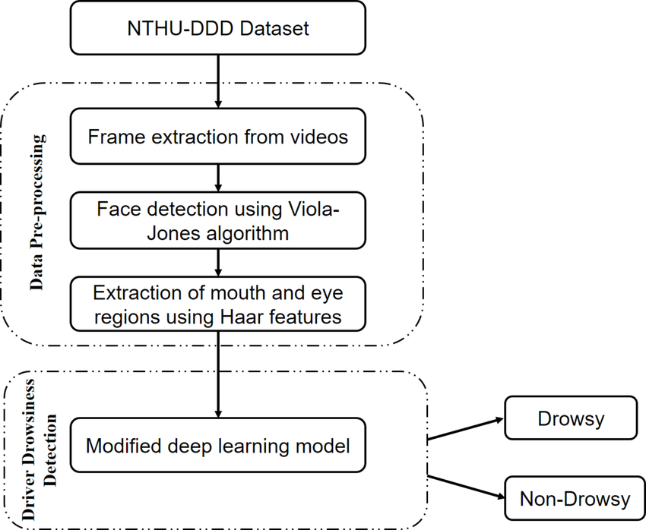
PROPOSED SYSTEM
11/06/2025

Slide 9
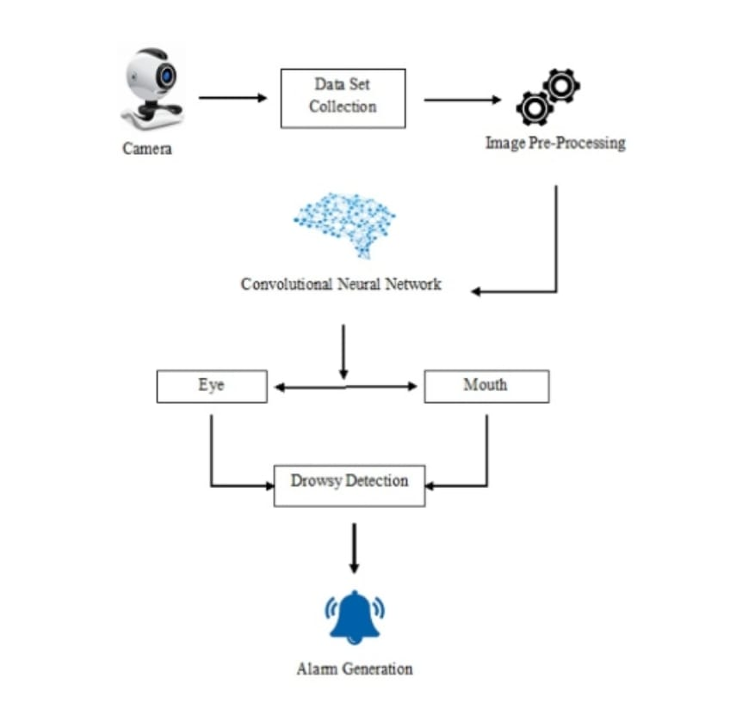
SYSTEM ARCHITECTURE
11/06/2025

Slide 10
MODULE 1 : Image Acquisition
Captures real-time video input using a webcam or camera.
Converts video frames into images for further processing.
Ensures consistent frame rate and image resolution.
Acts as the first step in the drowsiness detection pipeline.
11/06/2025

Slide 11
MODULE 2 : Face and Eye Detection Module
Uses Haar Cascade or deep learning models to detect face and eye regions.
Crops and isolates eyes from the detected face for precision.
Filters out irrelevant areas to reduce computation.
Supports real-time detection with high accuracy.
11/06/2025

Slide 12
MODULE 3 : Eye Aspect Ratio Calculation
Calculates the EAR using landmarks around the eyes.
Determines eye openness based on vertical and horizontal distances.
EAR is low when eyes are closed and high when open.
Outputs a continuous EAR value for each frame.
11/06/2025

Slide 13
MODULE 4 : Drowsiness Detection Module
Analyzes EAR trends over a sequence of frames.
Detects prolonged eye closure based on a threshold EAR value.
Sets a time window to confirm drowsiness (e.g., eyes closed > 2 seconds).
Triggers alert conditions when drowsiness is confirmed.
11/06/2025

Slide 14
MODULE 5 : Alert Generation
Activates audio or visual alerts when drowsiness is detected.
Logs the event for future analysis.
Can interface with vehicle systems for safety measures (e.g., slow down car).
Resets alert when eyes are open for a consistent period.
11/06/2025

Slide 15
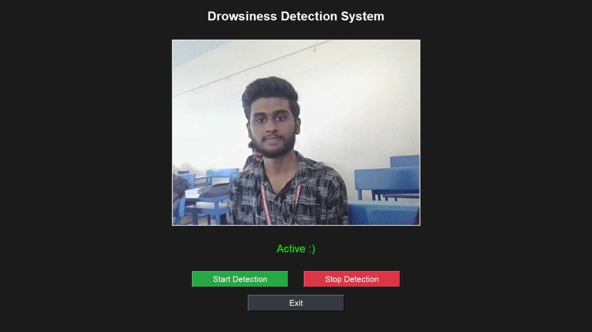
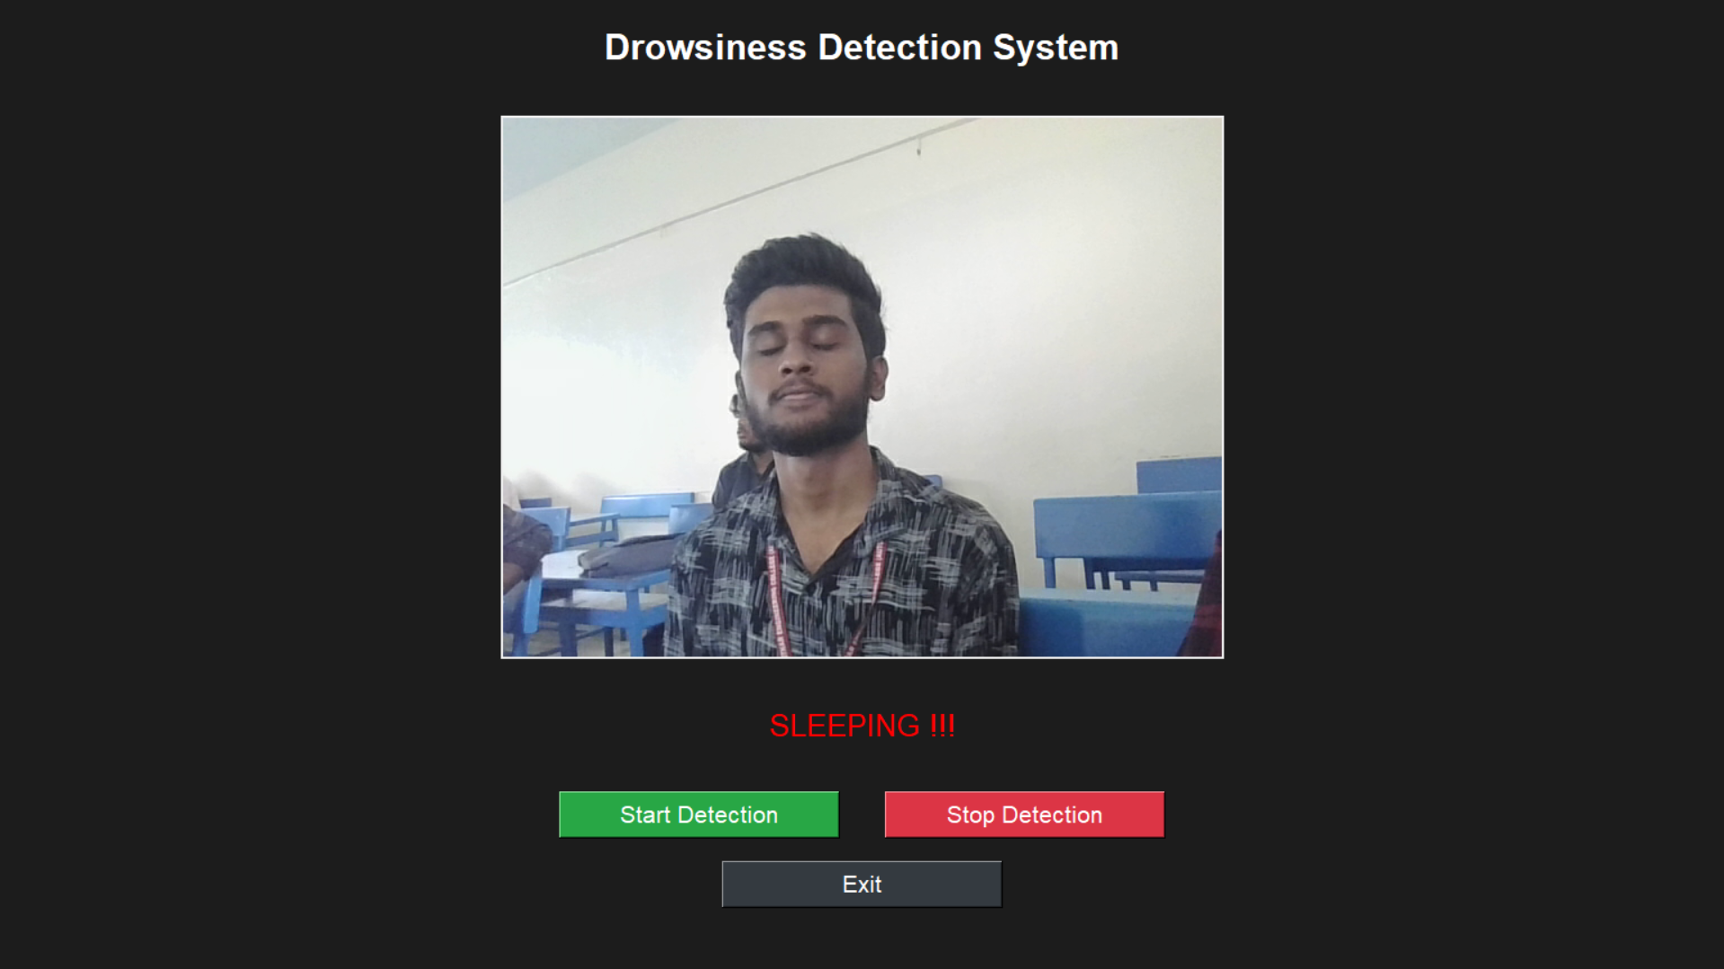
OUTPUT
11/06/2025

Slide 16
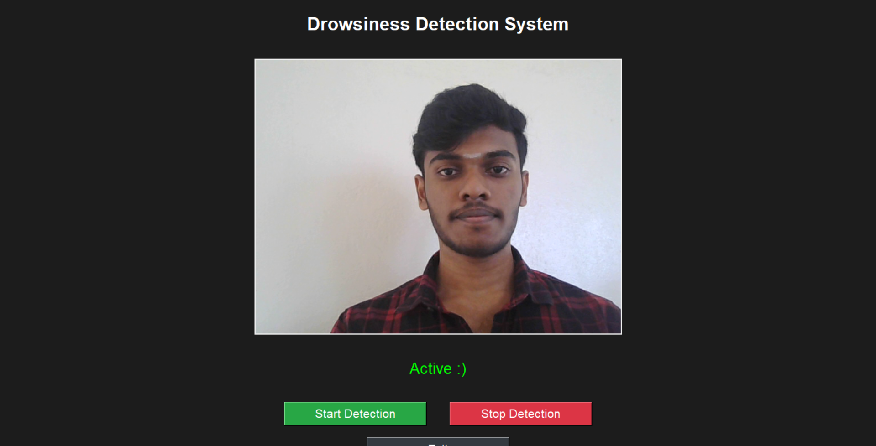
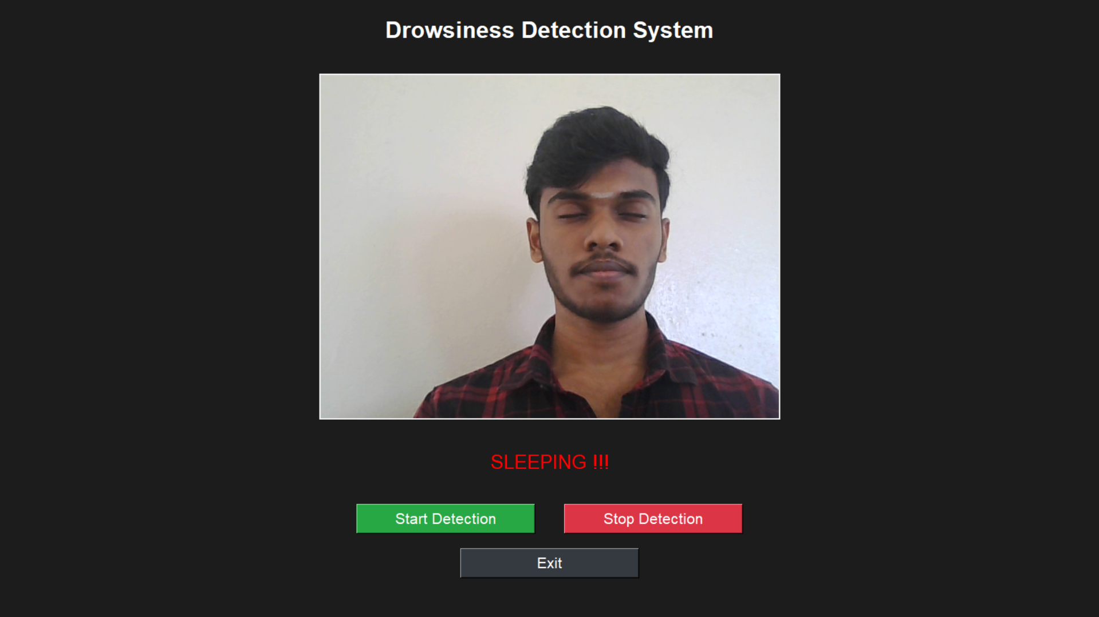
OUTPUT
DD/MM/YYYY

Slide 17
CONCLUSION & FUTURE ENHANCEMENT
The system continuously monitors the driver's facial expressions, including eye closure rate, blink duration, head position, and yawning frequency, to identify early signs of drowsiness.
To reduce false positives and enhance reliability, the system can integrate additional physiological and behavioral data sources such as heart rate variability, grip strength, steering behavior, and lane-keeping patterns.
By leveraging cloud infrastructure, the system can store and analyze large volumes of driving behavior and fatigue-related data over time.
11/06/2025

Slide 18
REFERENCES
H. Abtahi, B. Hariri, and S. Shirmohammadi, “Driver Drowsiness Monitoring Based on Yawning Detection,” Proc. IEEE Int. Instrumentation and Measurement Technology Conf., pp. 1–4, 2014.
A. George and A. Routray, “Real-Time Eye Gaze Direction Classification Using Convolutional Neural Network,” IEEE Trans. Neural Networks and Learning Systems, vol. 31, no. 7, pp. 2321–2329, 2020.
F. Faraji, F. Lotfi, J. Khorramdel, A. Najafi, and A. Ghaffari, “Drowsiness Detection Based on Driver Temporal Behaviour,” Proc. IEEE Conf. Artificial Intelligence in Transportation, pp. 114–119, 2021.
K. H. Lee, W. Kim, H. K. Choi, and B. T. Jang, “Driver’s Level of Drowsiness Detection Based on Facial Characteristics,” Proc. Int. Conf. Computer Vision and Driver Assistance, pp. 87–92, 2021.
11/06/2025

Slide 19

DD/MM/YYYY

